Slide 1
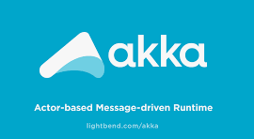

Adventures in Async: Part II Building Stateful Microservices with Akka Actors and OpenShift TALK Grant Steinfeld @gsteinfeld GitHub: Slides https://bit.ly/2IDSyHd Code https://bit.ly/2kMHXSp

Slide 2
Agenda 6:30 – 7pm Networking, Food 7:00 – 8:15pm Presentation and Technical demonstration 8:20 – 8:45 Q&A 9:00 - Wrap

Slide 3
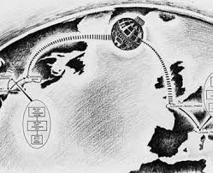
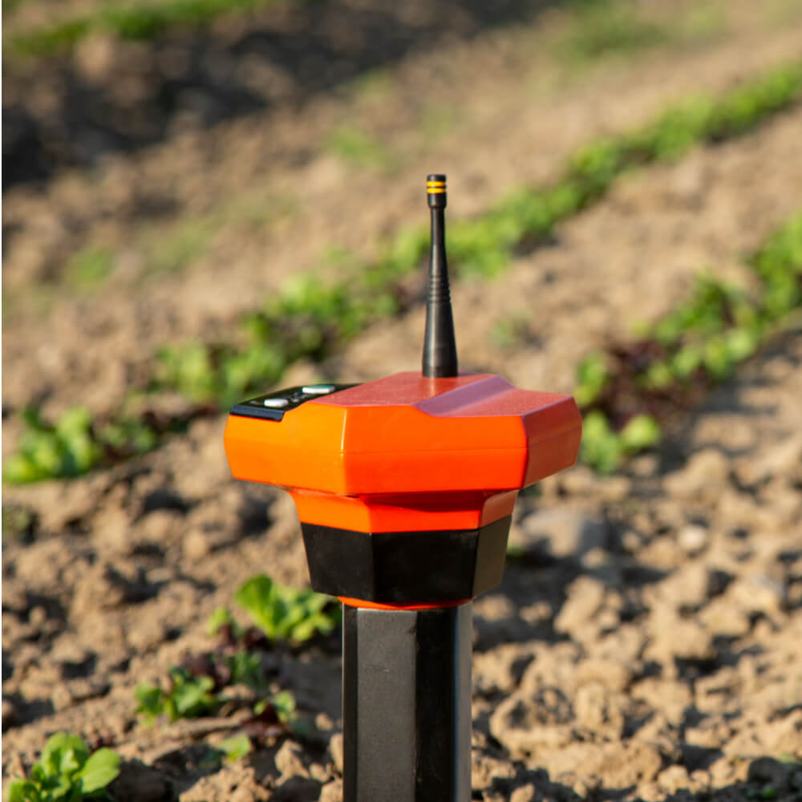
Acme Agrigate - Digital Farming Data Platform Hypothetically an IoT sensor metric real-time aggregator ~ 10 Million sensors – gps/temp/soil moisture ~ Million messages/minute ~ 99.9% reliablity
Reactive System Example
Notes:
OLTP server
Precision agriculture
Soil moisture probes
combines various technologies for water management into one central, cloud based, and powerful location designed for consultants and growers to take advantage of the benefits in precision irrigation via a simplified interface.

Slide 4
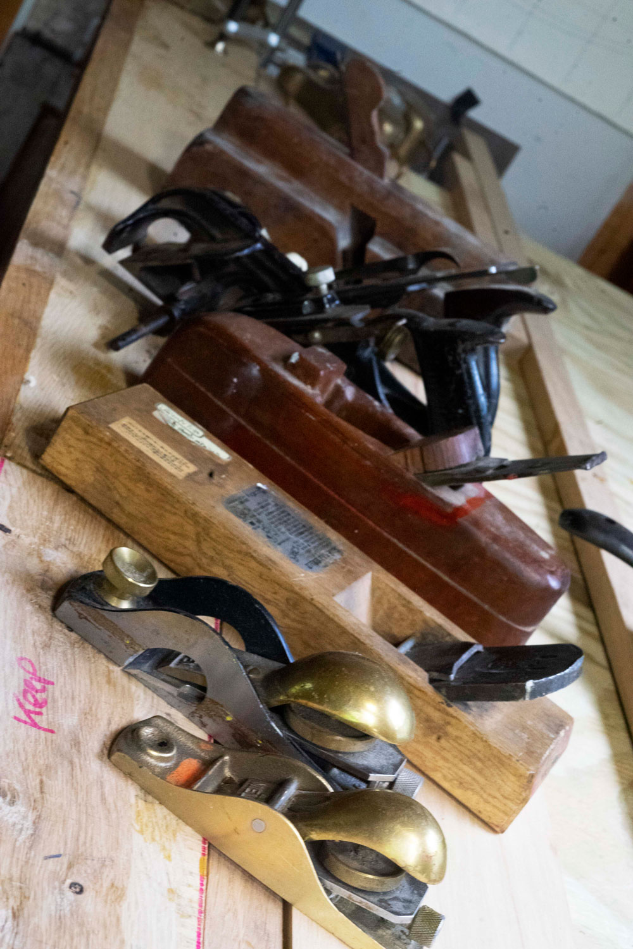
How do we build such a system?
Best fit Technology Stack
Architectural alternatives
Team size, skillset
Resources
Notes:
Knowledge of your
Technical and Product roadmap – Architects and Developers prepare to think what tools and methodologies to use to meet the business requirements

Slide 5

What is Reactive?
The Reactive Manifesto
Published on September 16 2014. (v2.0)
Organizations working in disparate domains are independently discovering patterns for building software that look the same.
These systems are more robust, more resilient, more flexible and better positioned to meet modern demands. ... We call these Reactive Systems.
https://www.ReactiveManifesto.org/
Notes:
Asynchronous Backends

Slide 6
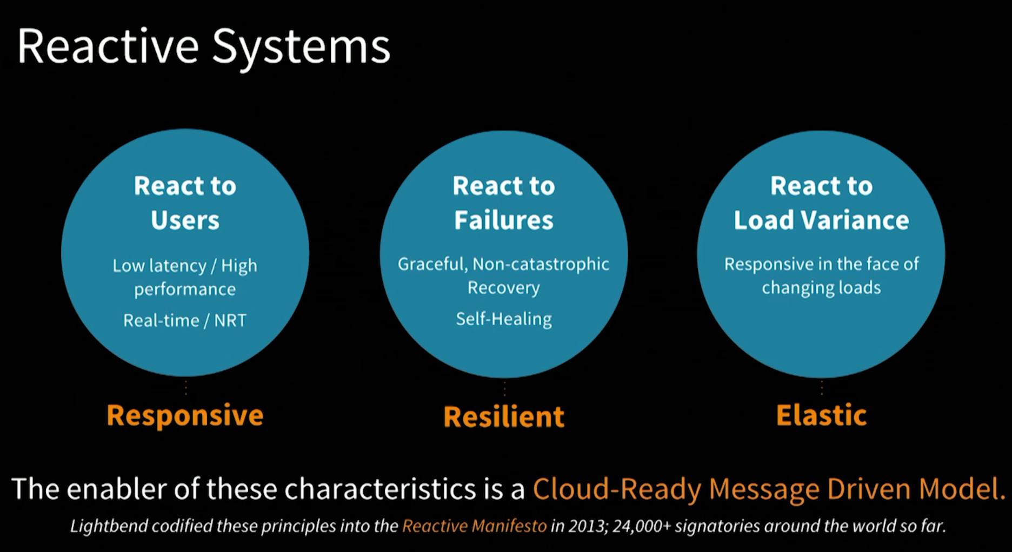
Reactive Systems - WOW
Message Flow
Notes:
K8s auto scale
Outside
Akka see more nodes = more capacity spread the work load
Inside

Slide 7
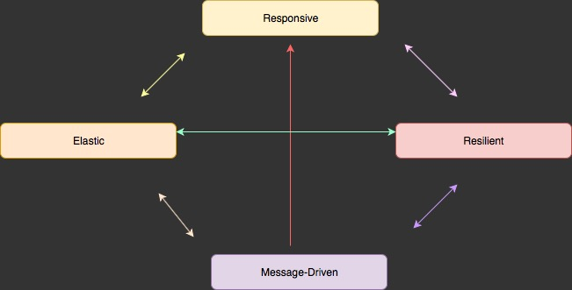
4 Reactive Principles

Slide 8
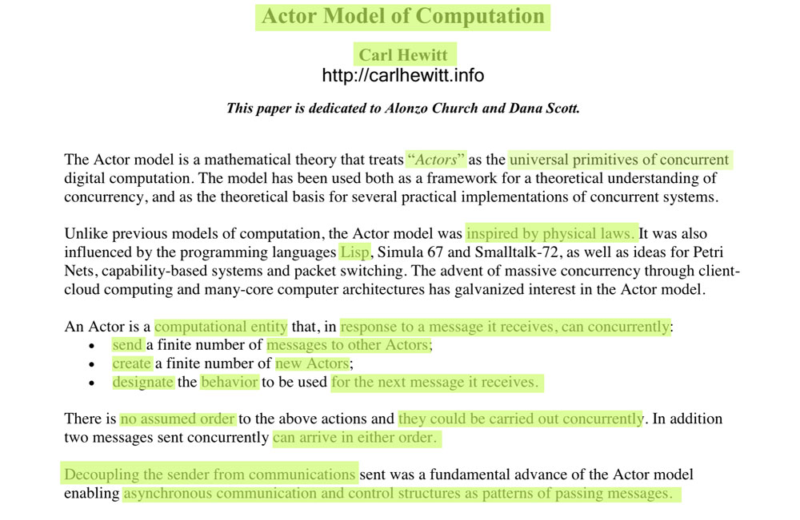
Actor Model Origins - 1977
Notes:
https://arxiv.org/ftp/arxiv/papers/1008/1008.1459.pdf
https://en.wikipedia.org/wiki/Lambda_calculus
Alonzo Church created lambda calculus
- 1930 influenced LISP programming lang and functional programming

Slide 9
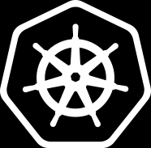


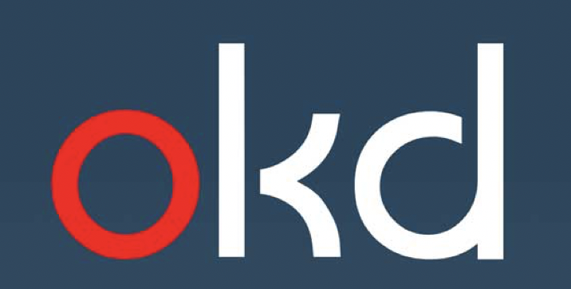

We propose a Reactive Stateful Microservice Architecture in an Orchestrated container paradigm
Dev.
Prod/Deploy
Notes:
Kubernetes is based on the concept of balancing the current state and the desired state, where the desired state is what you want your production environment to be, in other words, how many servers you want to be up and running for your application. The current state means the current status of your production environment.
Where our Stateful Microservice
Akka Actor application will run and be managed by K8s

Slide 10
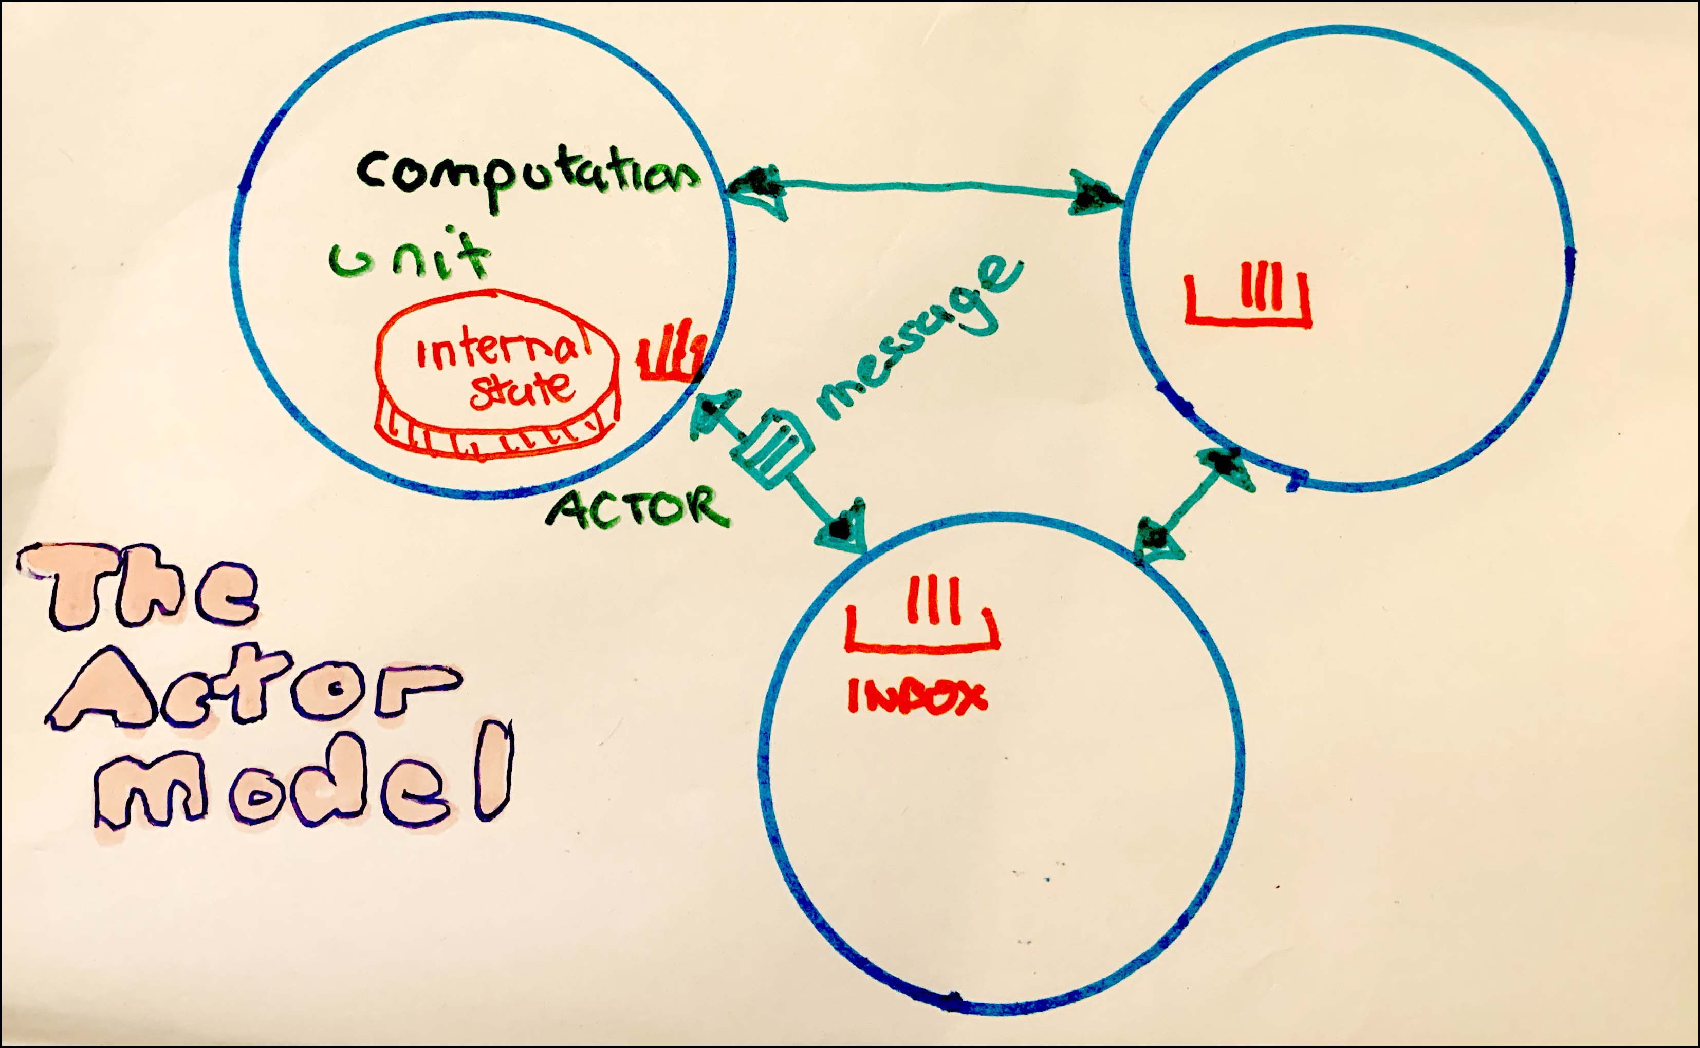
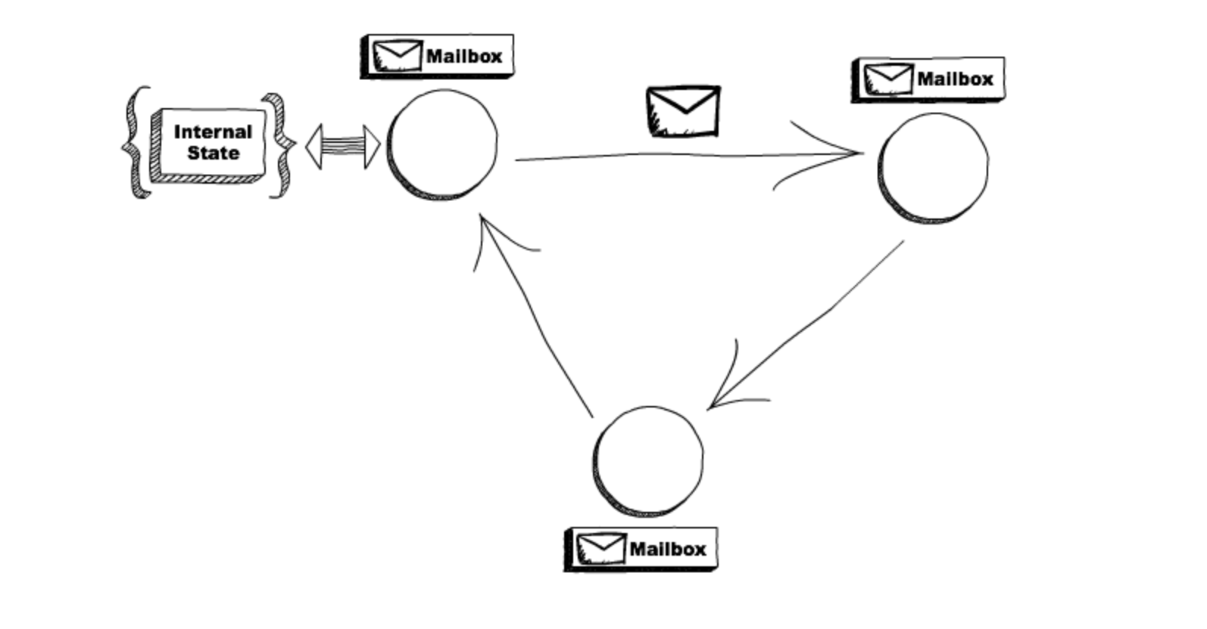
What is an Actor in software architectures?

Slide 11
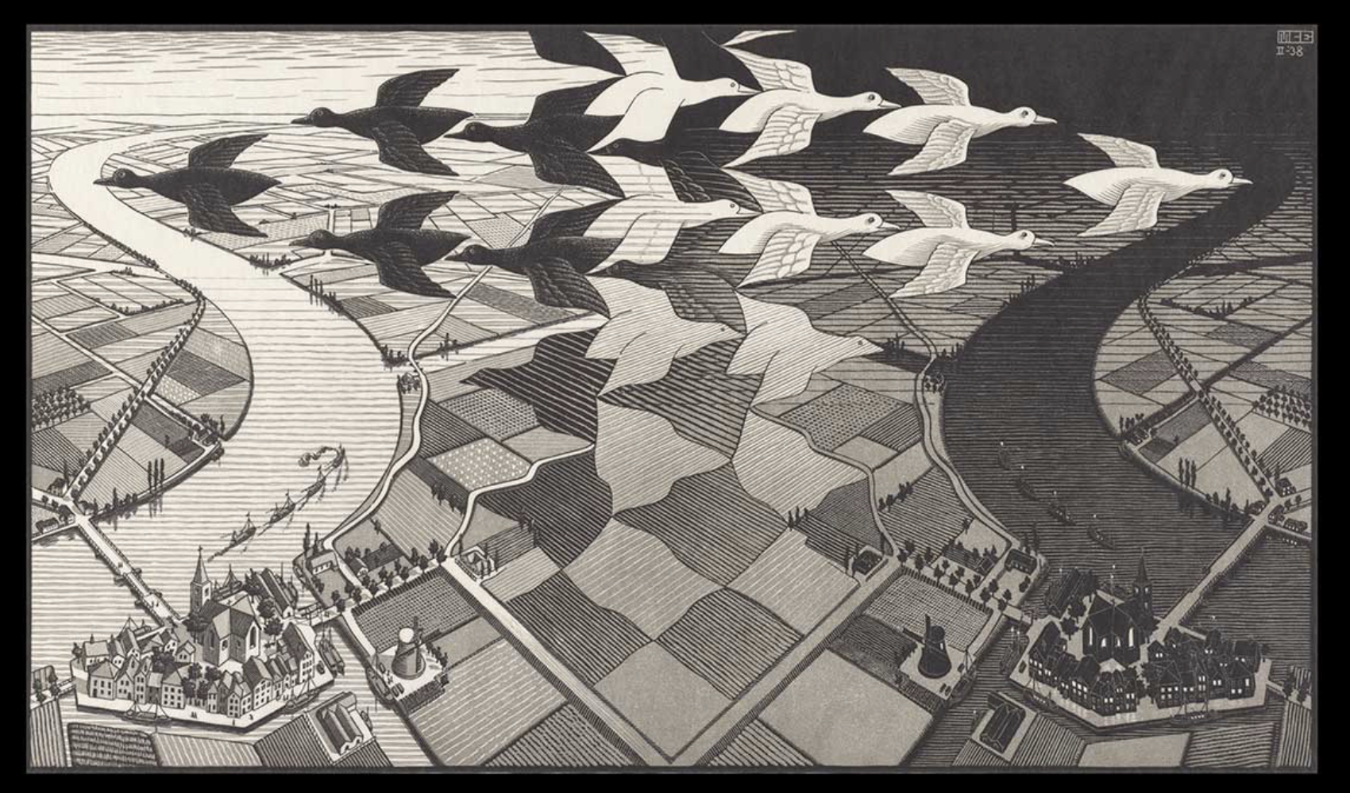
Actor Model
One ant is no ant
One actor is no actor
Ecosystem of multiple actors!
Message Flow

Slide 12
The actor model in computer science is a mathematical model of concurrent computation that treats "actors" as the universal primitives of concurrent computation.
In response to a message that it receives, an actor can:
make local decisions
create more actors
send more messages
determine how to respond to the next message received.

Slide 13
Actor Model
Each actor has a mailbox ( sequential queue )
Sequential processing in an individual actor
Message Flow

Slide 14
Actor Model
3 OPTIONS:
Create another 1-n new actors
Send messages to other actors
Mutate!
Designate what to do with the message ( can change it’s behavior ) → code example
ON_MESSAGE()
Message Flow

Slide 15
Supervisory Tree joins forces with K8s
Demo
//Scale out
/ /Scale in
Message Flow
Notes:
Self healing
Self balancing
One Ant

Slide 16
Supervisory Tree
Ecosystem
Self healing
Elastic
Stateful
Timeout
//CODE
Message Flow

Slide 17
Shard Actors
Mediator Pattern
Location Transparency
Notes:
Depend on mediator

Slide 18
Entity Actors
Lru?
Notes:
Name lamda params carefull is essential to the readibiity of stress pipelins
Use helper methods is more NB for readability in stream pipelines that in iterative code!

Slide 19
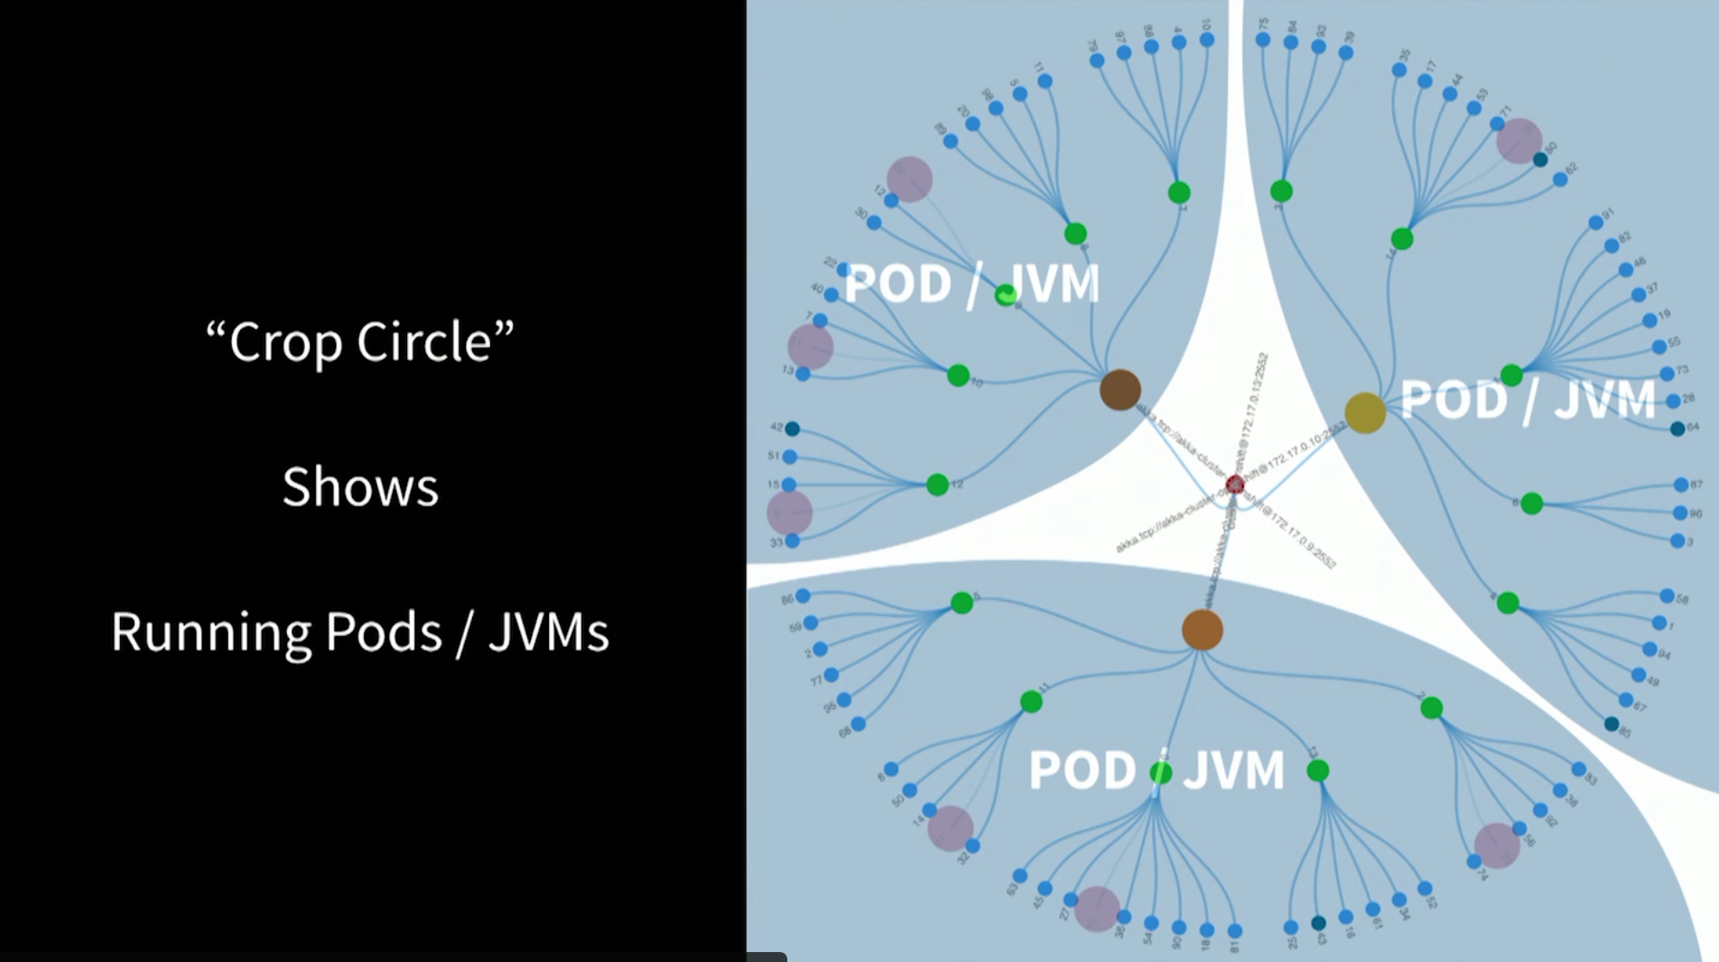
Demo – d3 visualization
Each Kubernetes Pod runs a single JVM

Slide 20
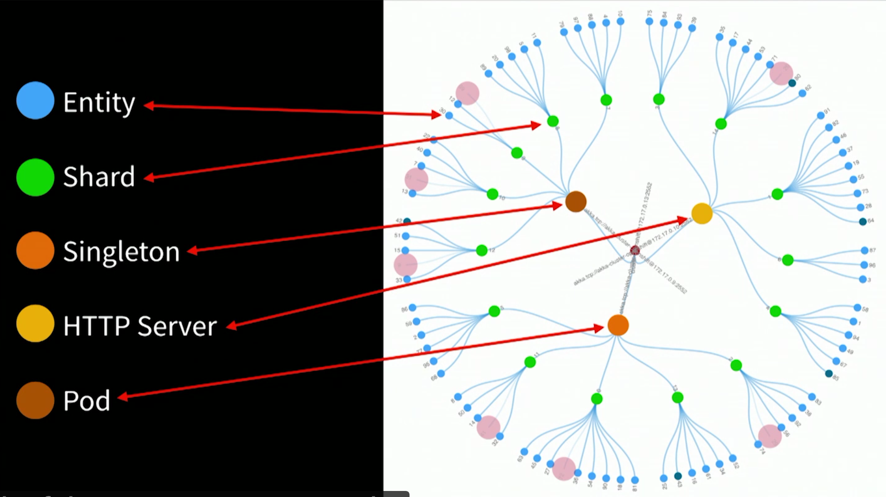
Demo – d3 visualization
Notes:
Microservice out on the perimeter Blue dots
State – banck occont or shopping cart or IoT device

Slide 21
Deliver value
Slices vs Layers
Commands
Queries
Notes:
Sep concerns

Slide 22
POJ app - Maven
POM.xml
Dependancies
Line 162 Shade – Jar Jar – to run in K8s – defines main()
Line 202 – creates Docker image – ports
8080
8558
2552
Message Flow
Notes:
Docker init start jar
Runner.java
Main akka system glorified thread pool
Starts some basic actors

Slide 23
k8s
2 yaml file
Akka-cluster-deployment
…
Line 7 Docker image name and tags
…
Message Flow
Notes:
I am not k8s expert yet!
Just want to run my jars
Don’t bore me with networkdeets
Just run myJvm
Reactive – not just async
Reactive systems
Always up

Slide 24
K8s pod changes
//Show GUI
Message Flow
Notes:
demo scale up
Demo scale down
More pods more JVM – load is spread – take a bit to com live
Drift over akka see’s these JVMs
Little pain
Akka drifts load over
K8s start up new JVM
Demo sjow lost pod
Missing part – k8s hlps
Not Akka
The beauty relationip

Slide 25
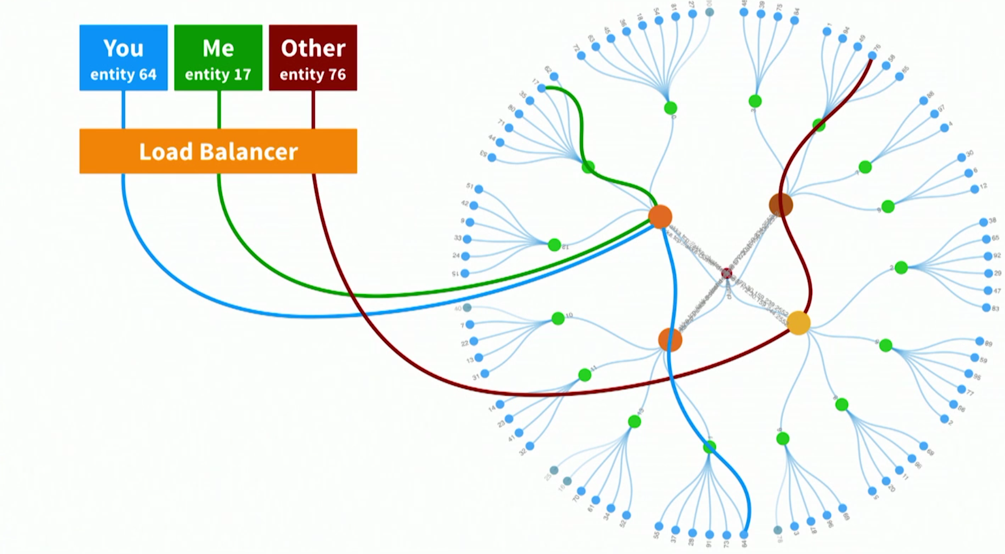
Cluster entity actors
Message Flow
Notes:
Client doing stuff on specific entity
Client does something on entity 64
Quick lookup – is this in this jVM – in other JVm request fwd
Blue line what shard
Is this mine
Is actor is alive
If yes fwd
If not creates actor – recovers state from DB –
Or most likely from
Event sourcing or CQRS

Slide 26

CQRS – simply separation of concerns
Command Query Responsibility Segregation
Command – Mutate State system
Query returning state system
Message Flow
Notes:
Create 2 objects when previously where there was one
Command Query Seperation
The term 'command query separation' was coined by Bertrand Meyer in his book "Object Oriented Software Construction" - a book that is one of the most influential OO books during the early days of OO.
Command(s) MUTATORS
At its heart is the notion that you can use a different model to update information than the model you use to read information.
Real life example --- Air Traffic Management (ATM) domain. We designed a solution for an ANSP, an Air Navigation Service Provider in charge to control a specific geographical area. The goal of the application was simple: compute and persist flight data. Resourse allocation

Slide 27
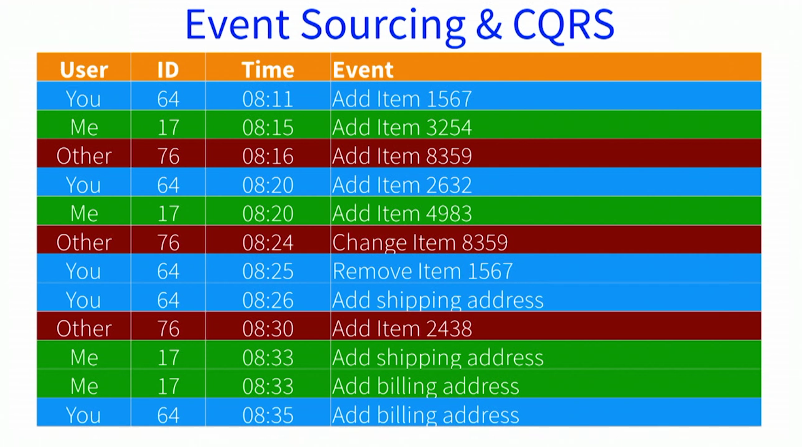
Event sourcing and CQRS
Command Query Responsibility Segregation
Message Flow
Notes:
Used a lot at customers
:
Store events not a db table
To get current state – replay events ( including –ve data like deletes – more interesting to data scheinctists )

Slide 28
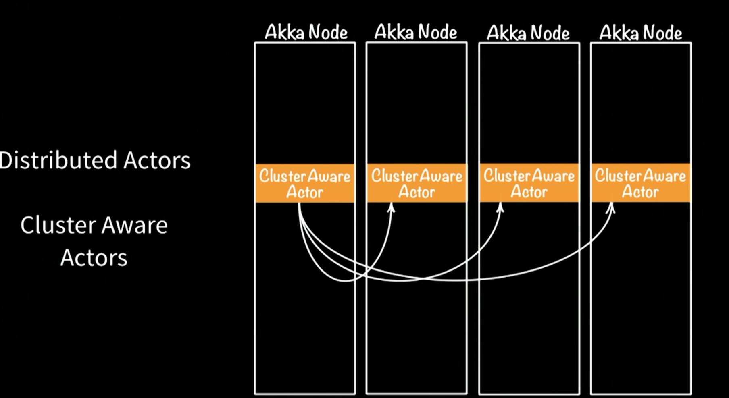
Cluster Aware Actors

Slide 29
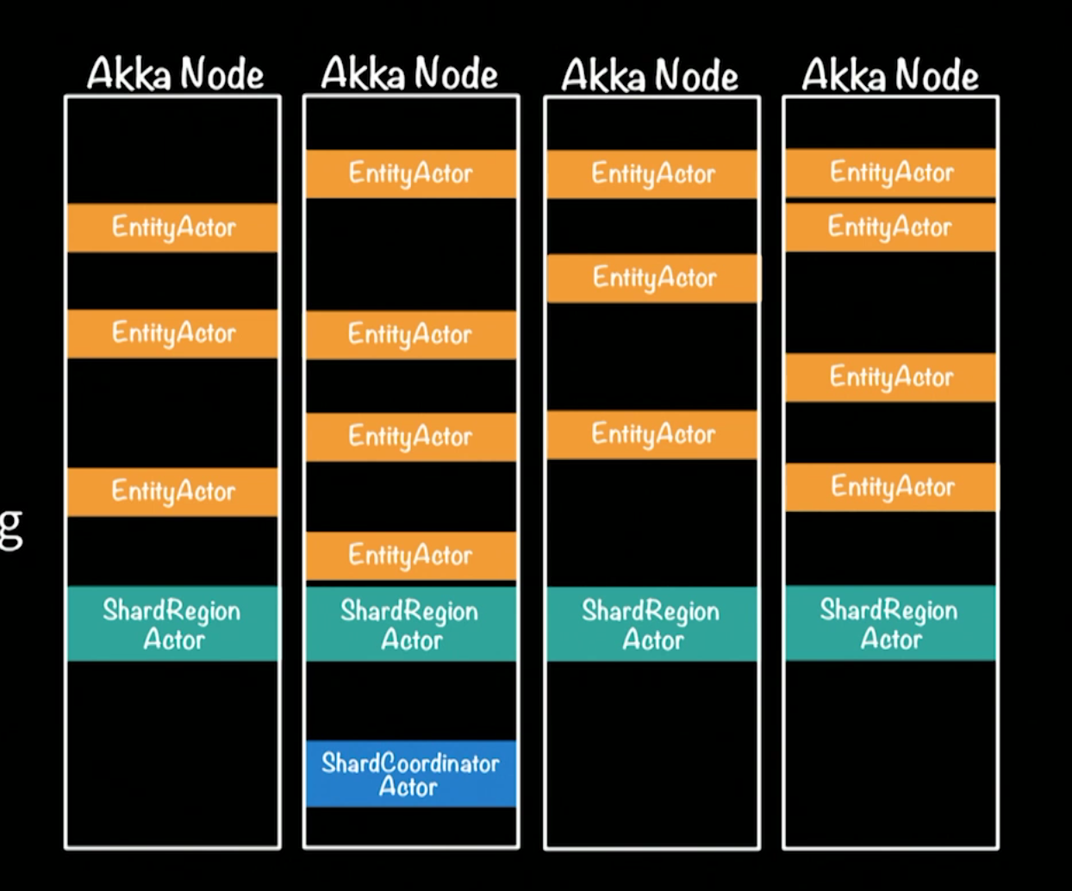
Akka Entity Distributed sharding
Notes:
Moer interesting shard region dist messages to right place in ecosystem
Entity only place where change – actor is the concurrency ‘multi-thrading’ only a single actor ( eg #67 )
Akka persistence – Cassandra etc -
But event log
Write side
Read side

Slide 30
Entity Command actor extends AbstractLoggingActor
View code
Message Flow
Notes:
Simple
Indirect message async – like texting
Sends message to itself
tickSending() line 49
getContext().become
Delegate routing to another actor shard region actor ( out of box ) - routhing
Tell() sends message
No http part – but has receiver to endpoint
Typed strongly – when receive command for 64
e.g. sensor event ( RAM ) no db in this example 9 but could
Highly optimized
10 years
40 000 000 msg/JVM

Slide 31
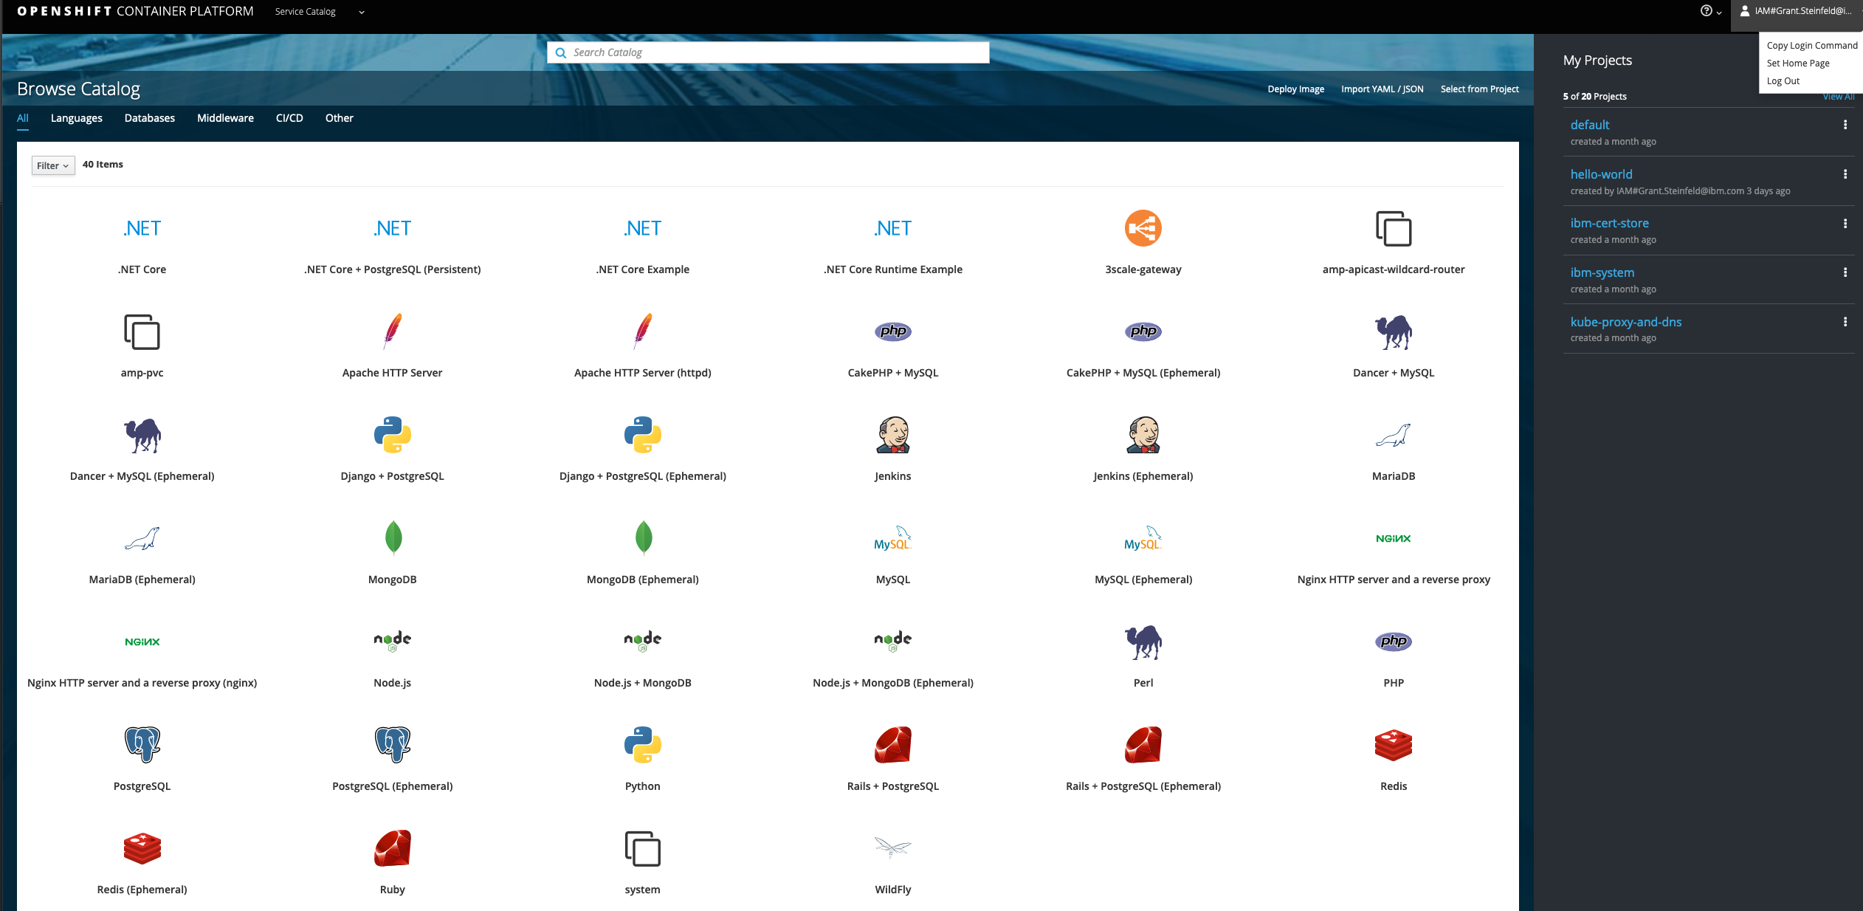
Copy oc Login Command and Verify $ oc login https://c110-e.us-south.containers.cloud.ibm.com:32427 --token=N-umsJh9_xJA-LI0aPZkrNdG-ACU0dRQ0oBNEbZl55w $oc config view
Notes:
oc login https://c100-e.us-south.containers.cloud.ibm.com:32627 --token=N-umsJh9_xJA-LI0aPZkrNdG-ACU0dRQ0oBNEbZlssw

Slide 32
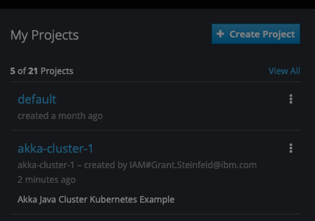
$oc new-project akka-cluster-1 --description="Akka Java Cluster Kubernetes Example" --display-name="akka-cluster-1” >> Now using project "akka-cluster-1" on server https://c100-e.us-south.containers.cloud.ibm.com:32627 git clone https://github.com/Grant-Steinfeld/akka-java-cluster-kubernetes.git cd akka-java-cluster-kubernetes && mvn clean package docker:build
Notes:
oc login https://c100-e.us-south.containers.cloud.ibm.com:32627 --token=N-umsJh9_xJA-LI0aPZkrNdG-ACU0dRQ0oBNEbZlssw
oc project akka-cluster-1
Already on project "akka-cluster-1" on server "https://c100-e.us-south.containers.cloud.ibm.com:32627".

Slide 33
#push to Docker Hub docker login docker whoami ls docker images docker tag akka-cluster-demo:1.0.0 grantsteinfeldibm/akka-cluster-demo docker tag akka-cluster-demo:1.0.0 grantsteinfeldibm/akka-cluster-demo:1.0.0 docker images docker push grantsteinfeldibm/akka-cluster-demo:1.0.0
Notes:
oc login https://c100-e.us-south.containers.cloud.ibm.com:32627 --token=N-umsJh9_xJA-LI0aPZkrNdG-ACU0dRQ0oBNEbZlssw
oc project akka-cluster-1
Already on project "akka-cluster-1" on server "https://c100-e.us-south.containers.cloud.ibm.com:32627".

Slide 34
#setup role & rolebinding $oc apply -f kubernetes/akka-cluster-rolebindging.yml >>role.rbac.authorization.k8s.io/pod-reader created >>rolebinding.rbac.authorization.k8s.io/read-pods created #deploy docker images $ oc apply -f kubernetes/akka-cluster-deployment.yml # imagePullPolicy: Always #create route oc expose deployment/akka-cluster-demo --type=NodePort --port 8080 OR
Notes:
oc login https://c100-e.us-south.containers.cloud.ibm.com:32627 --token=N-umsJh9_xJA-LI0aPZkrNdG-ACU0dRQ0oBNEbZlssw
oc project akka-cluster-1
Already on project "akka-cluster-1" on server "https://c100-e.us-south.containers.cloud.ibm.com:32627".

Slide 35
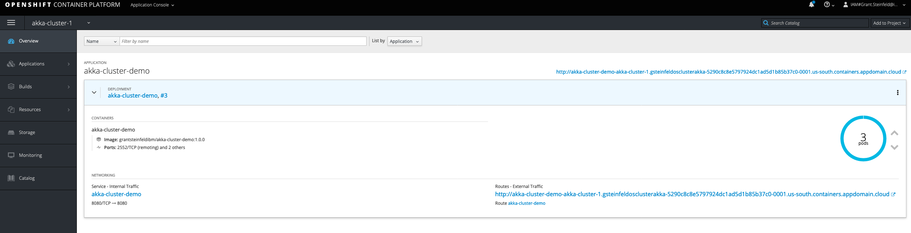
CHROME!!! https://bit.ly/2lSrLza http://akka-cluster-demo-akka-cluster-1.gsteinfeldosclusterakka-5290c8c8e5797924dc1ad5d1b85b37c0-0001.us-south.containers.appdomain.cloud/
Notes:
oc login https://c100-e.us-south.containers.cloud.ibm.com:32627 --token=N-umsJh9_xJA-LI0aPZkrNdG-ACU0dRQ0oBNEbZlssw
oc project akka-cluster-1
Already on project "akka-cluster-1" on server "https://c100-e.us-south.containers.cloud.ibm.com:32627".

Slide 36
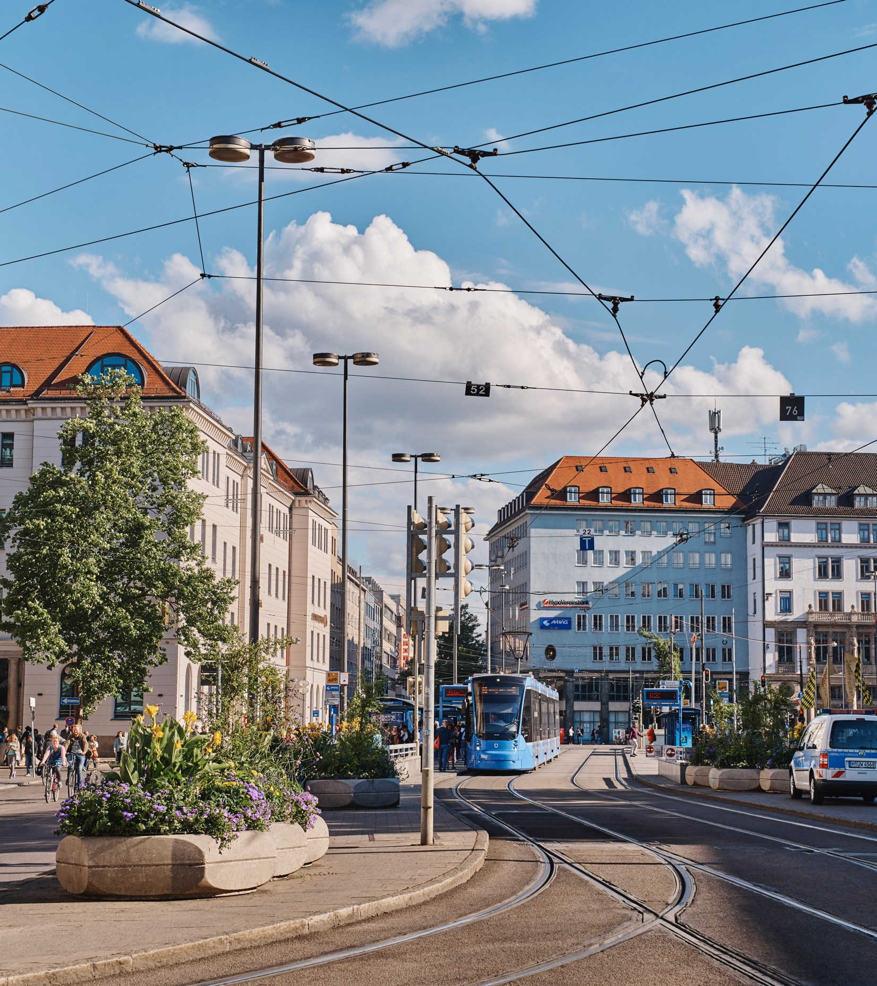
Q&A
Customers
Paypal 1 Billion Tx/Day
Bad to block – does it block – how to tell if it’s alive
Actors async – should be quick op – ‘stuck thread’
Thread starvation tool ( broken ? ) / DB sync?
Dispatchers thread pools
Some for blocking
Some for non-blocking
MAIL box
Reactive streams – backpressure if down stream slower slow down producer Akka is Java/Scala
Written in Scala – Java and Scala API
Examples Java
GitHub - Scala
Notes:
Be aware of blocking!

Slide 37
Resources code for this presentation https://github.com/mckeeh3/akka-java-cluster-openshift Reactive https://developer.ibm.com/technologies/reactive-systems/ https://www.reactivemanifesto.org/ Akka Actors https://doc.akka.io/docs/akka/current/actors.html Hewitt, Meijer and Szyperski: The Actor Model (everything you wanted to know...) https://www.youtube.com/watch?v=7erJ1DV_Tlo&t=2s Kubernetes – OpenShift – Minishift https://www.okd.io/minishift/ CQRS/EVENT SOURCING http://udidahan.com/2011/10/02/why-you-should-be-using-cqrs-almost-everywhere/ https://hackernoon.com/lessons-ive-learned-building-distributed-systems-with-cqrs-and-event-sourcing-ece284ecc1a1 https://martinfowler.com/bliki/CQRS.html https://cqrs.files.wordpress.com/2010/11/cqrs_documents.pdf

Slide 38
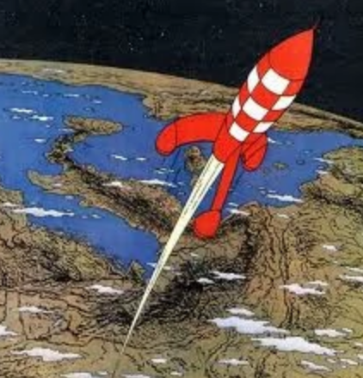
Upcoming Events @gsteinfeld How to Write, Debug, and Test Smart Contracts ( Sept 18th ) Akka Actors https://www.vtcodecamp.org/ ( Sept 28th ) Intro to predictive data analysis using Apache Kafka, Spark, Zeppelin on JVM ( Oct 7th ) other meetups, workshops, interactive webinars
Check in periodically at https://www.meetup.com/ibmcodenyc

Slide 39

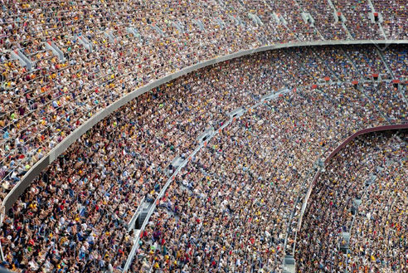
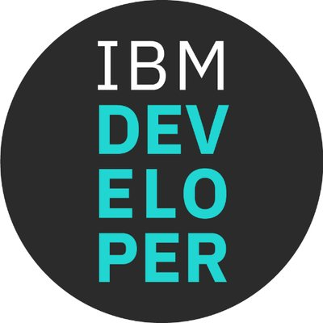
Thank You
Sign up onto the ibm cloud platform to experiment with OpenShift https://ibm.biz/Bdzbb8
@gsteinfeld
https://developer.ibm.com/profiles/grant.steinfeld

